Slide 1
Input Signal
Output Signal
RF Amplifier
TR Switch
Tuning Circuit
Coil
Specimen

Slide 2
Input Signal
RF Amplifier
TR Switch
Tuning Circuit
Coil
Specimen
Amplified Signal
Switch passes signal through
Tuned Signal
Excitation Field

Slide 3
Output Signal to ADC
RF Pre-Amplifier
TR Switch
Tuning Circuit
Coil
Specimen
Switch passes signal to output
Filtered Signal
Electric Signal
FID Signal

Slide 4
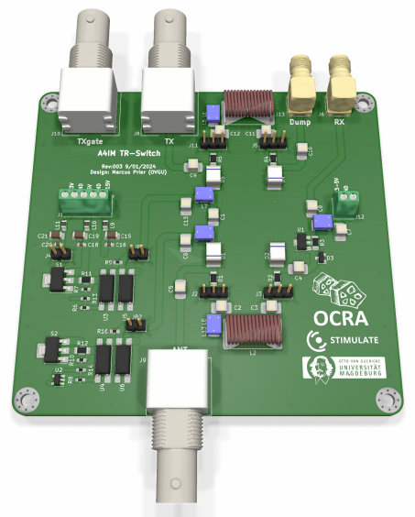
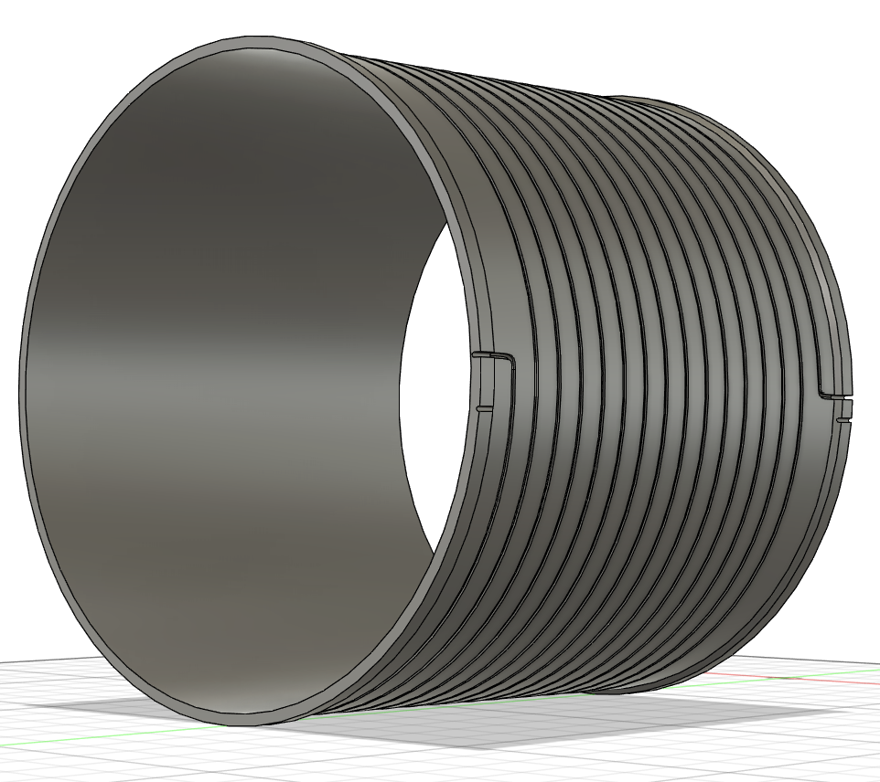

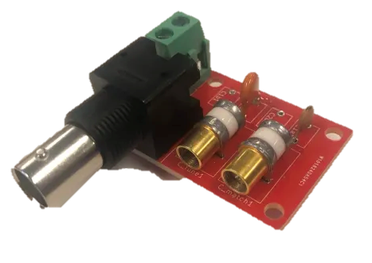
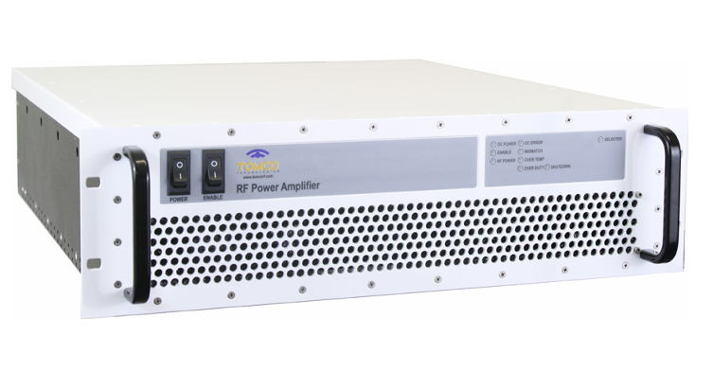

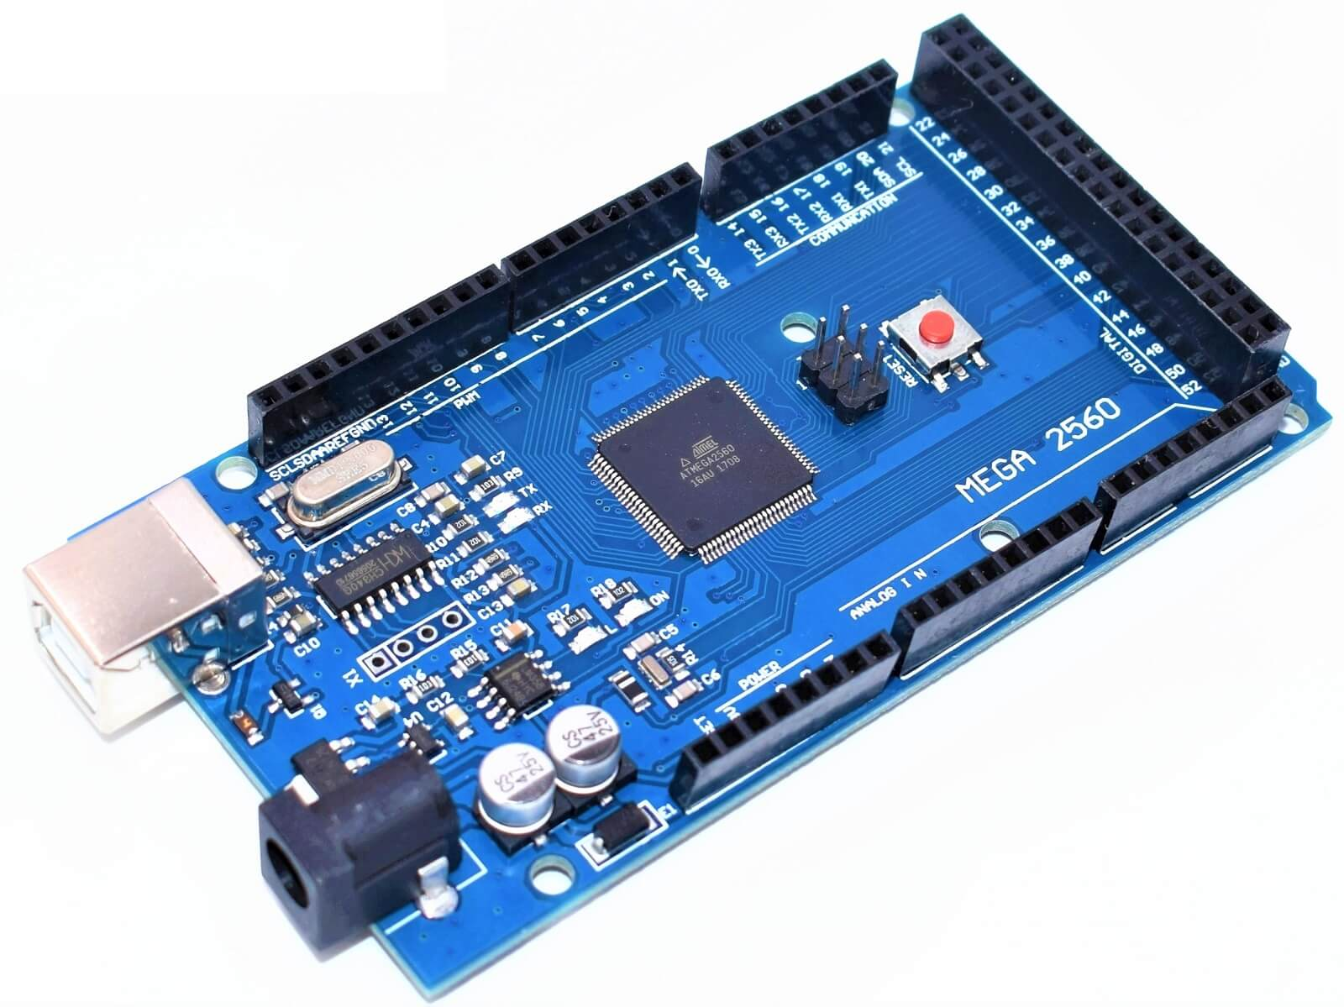
Input Signal
Output Signal
Free Induction Decay
RF Amplifier
Tuning Circuit
Coil
TR Switch
RF Excitation
DB25 Interface
Serial
Arduino
GUI

